Slide 1
II. A Crash Course in C
Jalal Kawash

Slide 2
Section 1 Objectives At the end of this section you will
ARM I
Architecture
Learn how to write programs in C
Use C pointers and athematic
Exploit I/O files
Create processes and threads
Mix C and Assembly

Slide 3
Outline
ARM I
Architecture
Basics
Functions
Branching and looping
Arrays
Pointers
Structures and memory allocation
Files
Processes
Threads
Mixing C and Assembly

Slide 4
Basics

Slide 5
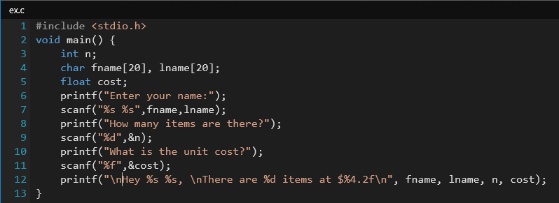
Example C Program

Slide 6
Basic Data Types
Type | Bytes | Use
int | 4
char | 1
float | 4
double | 8
short | 2 | short int
long | 8 | long int
unsigned | 4 | unsigned int

Slide 7
Conversion and Casting
C can do type conversions
In general, a smaller-size type can be converted to a larger-size type
E.g. float = int
Explicit conversion is done as follows:
(datatype) expression
avg = (float) sum/total

Slide 8
Basic Operators
Addition
Subtraction
Multiplication
Division
Modulus division

Slide 9
Functions

Slide 10
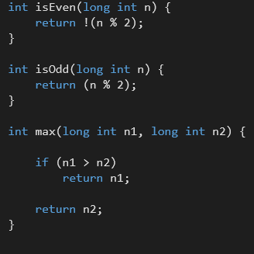
Functions

Slide 11
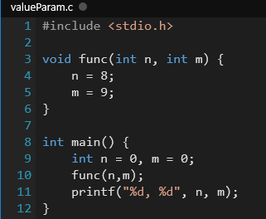
Value Parameters
Do not change outside the function
Output: 0, 0

Slide 12
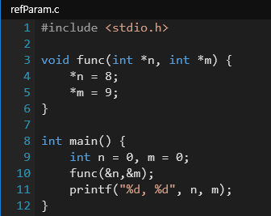
Reference Parameters
Change outside the function
*n is a pointer = variable holding the address on n
&n = address on n
Output: 8, 9

Slide 13
Command-line Arguments
Mechanism to collect user input from the command line:
prog <list of arguments>
The main method can have two arguments:
argc = argument count
argv = argument vector
int main(argc,argv)
int argc;
int *argv[];
{
…
}

Slide 14
Command-line Arguments
argc is computed by the compiler
argv[0] = program name

Slide 15
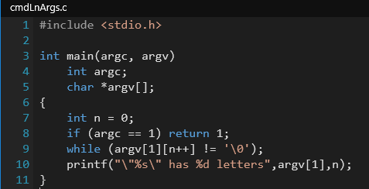
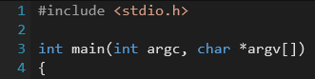

Slide 16
Branching and Looping

Slide 17
Comparison and Logical Operators
Comparison: ==, !=, <=, >=
Logical:
AND: &&
OR: ||
NOT: !

Slide 18
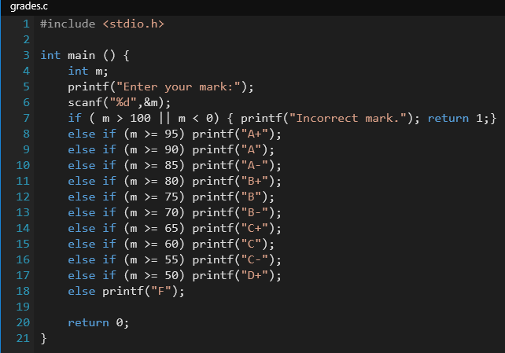
If Statement

Slide 19
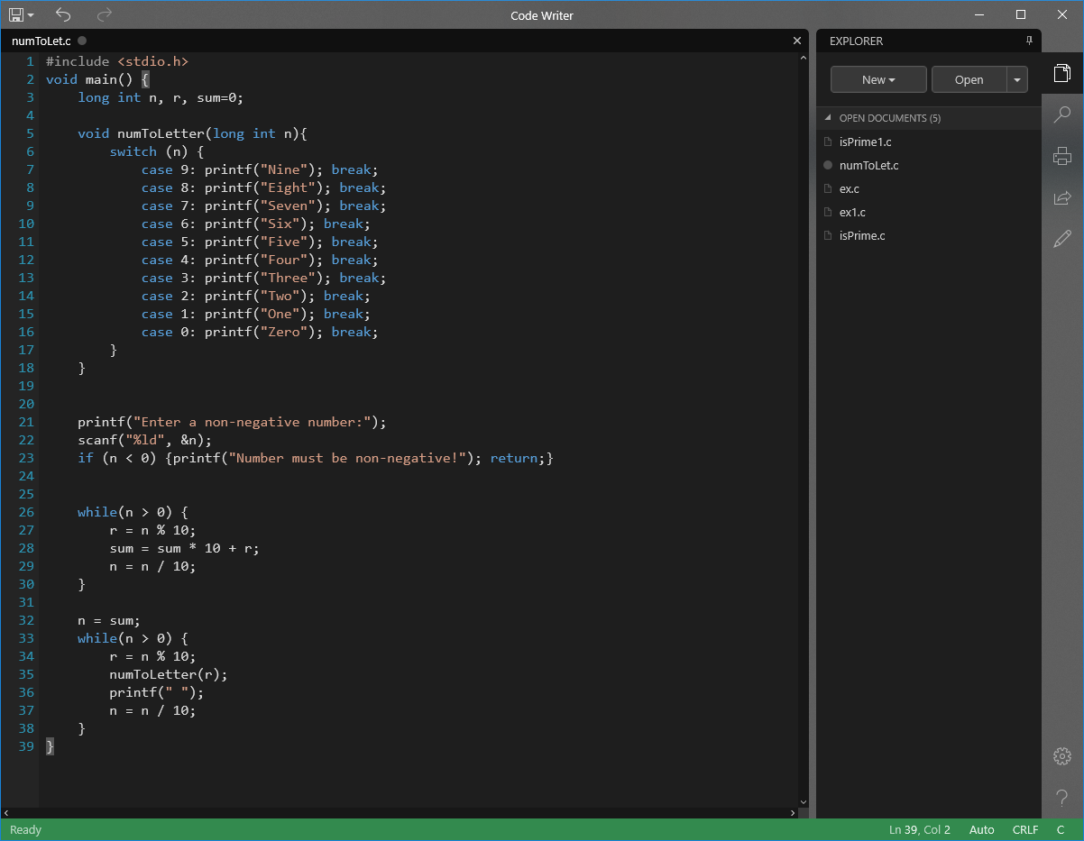
Switch Statement

Slide 20
Bitwise Operators
Bitwise AND | &
Bitwise OR | |
Bitwise XOR | ^
Left Shift | <<
Right Shift | >>
One’s complement | ~

Slide 21
Examples
value = eFlag & mask
value = eFlag >> n
value = eFlag << 3
value ~= eFlag
value |= eFlag
value = (~0 ^ eFlag) << 5

Slide 22
While Loop
while (condition) {
body
}

Slide 24
Do-While Loop
do {
body
} while (condition);
Equivalent to:
body
while (condition) {
body
}

Slide 25
For Loop
for (initialization; condition; incrementation){
Body
}
int i;
for(i = 0; i < 100; i++)
printf("%d ",i);

Slide 26
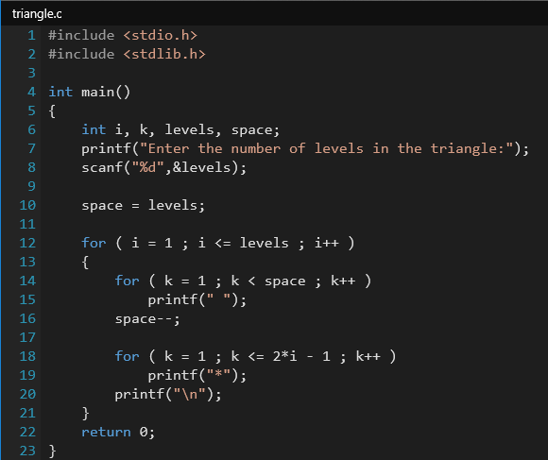

Slide 27
continue and break
while (…) {
…
if(…) break;
…
}
while (…) {
…
if(…) continue;
…
}

Slide 28
Arrays

Slide 29
Arrays
To declare:
int y[100];
int x[10][20];
Static and external (to main()) arrays can be initialized
static int y[] ={1,2,3,4,5,6};
int x[2][3] = {1,2,3,4,5,6}
// row major

Slide 30
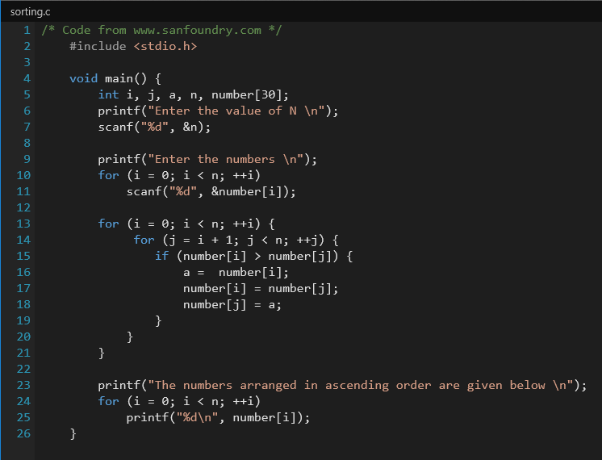

Slide 31
Pointers

Slide 32
Pointers
A variable that contains an address (for another object in memory)
The address operator & returns the address of a variable
The indirection operator * declares a pointer variable

Slide 33
Pointers Example
int n = 100;
int *ptr;
ptr = &n;
int m = *ptr
Variable n at some address abc
abc
100
Variable ptr at some address fgh
fgh
?
fgh
abc
Variable m at some address lmn
lmn
100

Slide 34
Pointers Example
Variable n at some address abc
100
abc
Variable ptr at some address fgh
int m;
m = ptr;
m = *ptr;
abc
fgh
Variable m at some address lmn
lmn
abc
Variable m at some address lmn
lmn
100

Slide 35
Arrays and Pointers
The array name (a) is a pointer to the first element in an array (a[0])
int a[N], *ptr;
ptr = a; // array has two names now
ptr+n or a+n refer to a[n]

Slide 36
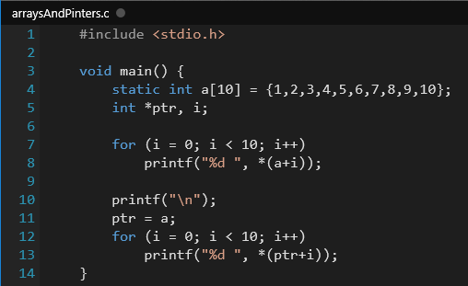

Slide 37
Pointer Arithmetic
int a[N], *ptr;
ptr = a; // array has two names now
ptr+n or a+n refer to a[n]
a and ptr must be the same type
a+n is n “type size” from a
Type size depend on the type of a
2 bytes for int, 1 for char, 4 for long, etc …

Slide 38
Byte Addresses
Memory Bytes
short *ptr;
ptr + 0
ptr
ptr + 1
ptr + 2
ptr + 3

Slide 39
Byte Addresses
Memory Bytes
char *ptr;
ptr + 0
ptr + 0
ptr + 2
ptr + 3
ptr + 4
ptr + 5
ptr + 6
ptr + 7

Slide 40
Byte Addresses
Memory Bytes
float *ptr;
ptr + 0
ptr
ptr + 1

Slide 41
Pointer Arithmetic
A pointer may be displayed as an unsigned variable
Pointers can be incremented or decremented
ptr++;
ptr -= 2;

Slide 42
Pointer Arithmetic Examples
float a[100], fptr;
fptr = &a[0];
The following equalities hold
fptr + 5 == &a[5]
++fptr + 5 == &a[1]

Slide 43
Pointer Arithmetic Examples
float a[100], fptr;
fptr = &a[0];
fptr--;
The following equalities hold
*fp == a[0]
*(fp) == a[0]
*(fp + 6) == a[6]
*(fp + 6) == a + 6

Slide 44
Your Turn
What does the following declare?
float *a[];

Slide 45
Examples of Operations on Pointers
Obtaining the pointer’s address
int n,*p1,*p2;
p1 = &n;
p2 = &p1;
A pointer can be declared as a pointer to a pointer
int **p2;

Slide 46
Examples of Operations on Pointers
Adding or subtracting
p1++;
Indirect operator
int n,m,*p1,*p2;
p1 = &n;
P2 = &m
*p1 = 20; \\ assign 20 to n
*p2 = 4 + (*p1)
\\ assign 4 + the value of n to m

Slide 47
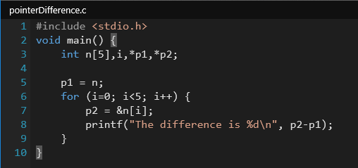
Examples of Operations on Pointers
Finding the address of a pointer
p2 = &p1;
Finding the difference between two pointers

Slide 48
Strings
A string is a character array terminated with NULL
char *name; \\ name[i] is a char
char *name[10]; \\ name[i] is a string

Slide 49
Pointers to Functions
Declared as
type (*funcName)();
Example: int (*f1)();
Declares a pointer to a function that returns int
Careful: int *f1();
Declares a function returns a pointer to int

Slide 50
Pointers to Functions
void *runner(void *param)
{
…
}
pthread_create(&tid, &attr, runner, argv[1]);

Slide 51
Structures

Slide 52
Structures
Groups variables into a record
struct Student {
long int id;
char fname[20];
char lname[20];
};
struct cpsc359 Student[50];
cpsc359[15].id = 12345678;

Slide 53
Unions
Similar to structures in syntax, but only holds the value for one member only
union Answers {
int answer1;
float answer2;
} someAnswers;
someAnswers.answer1 = 12;
someAnswers.answer2 = 15.5;
\\ erases answer1!

Slide 54
Memory Allocation

Slide 55
Memory Allocation
Declaring a pointer to a buffer will only reserve memory for the pointer, not the buffer
Functions to allocate (reserve) memory in C:
malloc()
alloc()
realloc()
calloc()
free()

Slide 56
ptr = malloc(size)
Allocates size contiguous bytes
ptr is a pointer to char type
If allocation fails, malloc returns 0
Include #stdlib.h
unsigned int size = 1024;
char *ptr;
ptr = malloc(size);

Slide 57
Allocating a buffer ot 1024 floats
unsigned int size = 1024;
float *ptr;
ptr = (float *)
malloc((sizeof) float) * size);

Slide 58
ptr = alloc(size)
Not available in all systems
Similar to malloc(), but initializes the buffer to zeros.

Slide 59
ptr = realloc(ptr,newSize)
Reallocates the old buffer of ptr to newSize
Buffer can grow or shrink
unsigned int size = 1024;
char *ptr;
ptr = malloc(size);
…
ptr = realloc(ptr, size*2);

Slide 60
ptr = calloc(n,objSize)
Allocates a buffer of objects
Used to allocate memory for non-simple types
Such as structures
n is the buffer size
objSize is the size of individual object size

Slide 61
free(ptr)
Frees the space originally allocated with pointer ptr

Slide 62
Files

Slide 63
Files
Declare: FILE *inFile, *outFile;
Open: inFile = fopen(“fork.c”,”r”);
outfile = fopen(“fork1.c”,”w”);
Read: fscanf(inFile, “%c”, ch);
Write: fprintf(outFile, “%c”, ch);
Close: fclose(inFile);
fclose(outFile);

Slide 64
Files
EOF: Delimits the end of a file
while (ch = fgetc(inFile) != EOF) {…}
fopen returns NULL if unsuccessful

Slide 65
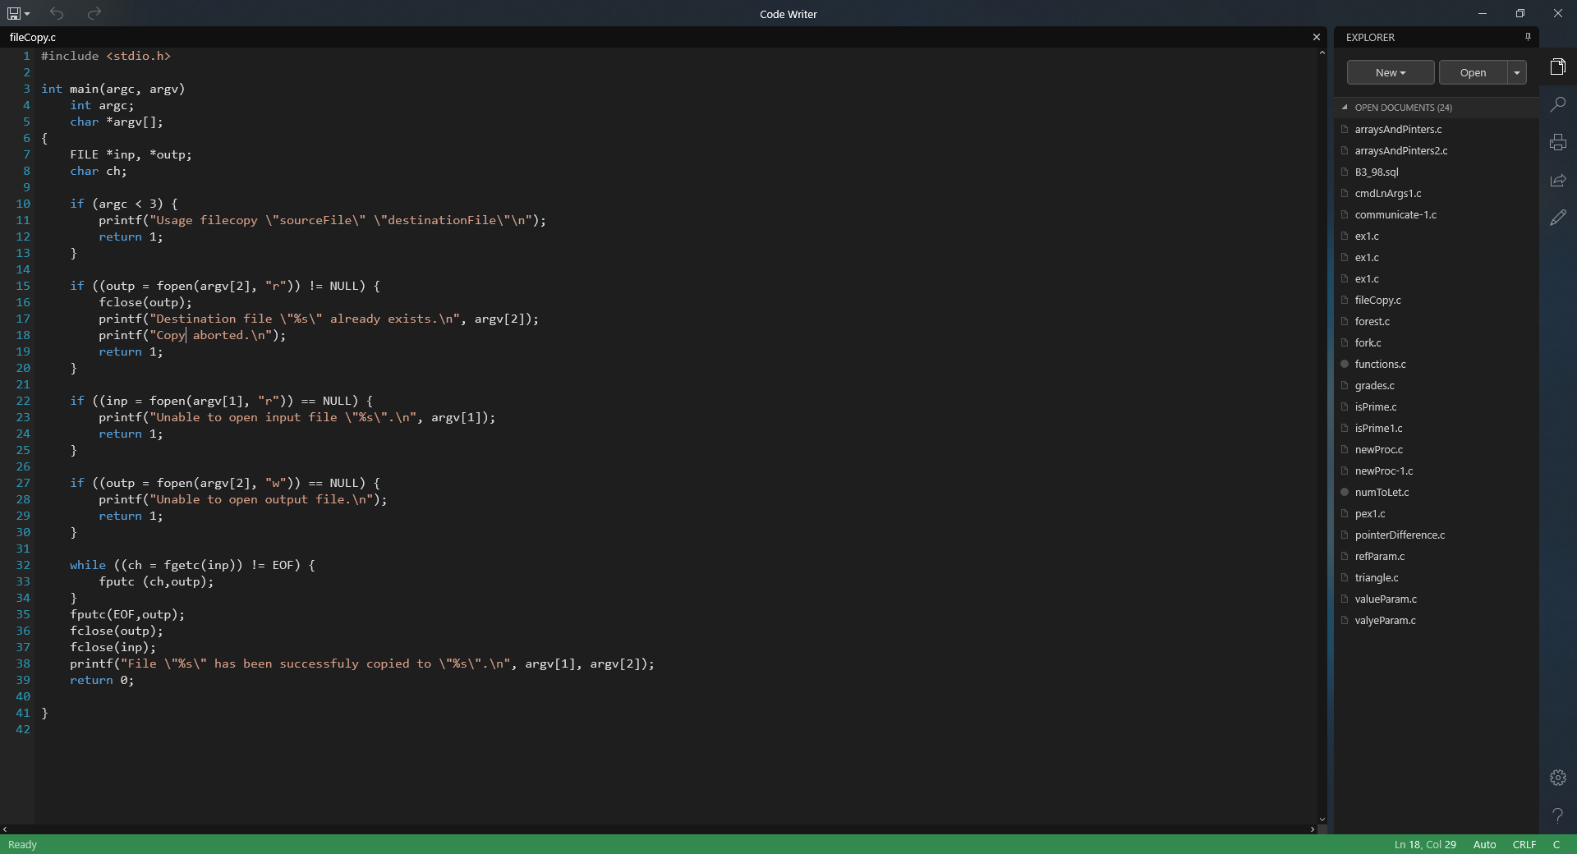

Slide 68
Processes

Slide 69
Processes
A process is a program in execution
A program is a passive entity
A process is an active entity
Consumes resources
Changes states

Slide 70
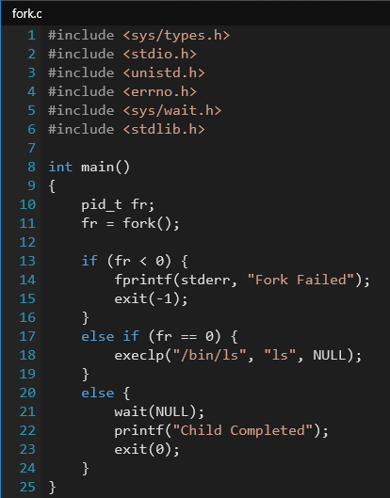

Slide 71
fork.c
int main() {
pid_t fr;
fr = fork();
if (fr < 0) {
fprintf(stderr, "Fork Failed");
exit(-1);
} else if (fr == 0) {
execlp("/bin/ls", "ls", NULL);
}
else { /* fr > 0 */
wait (NULL);
printf ("Child Complete");
exit(0);
}
}

Slide 72
int main() {
pid_t fr;
/* fork another process */
fr = fork();
if (fr < 0) { /* error occurred */
fprintf(stderr, "Fork Failed");
exit(-1);
} else …
fork.c
fork() creates a child process.
Child process has same text section as parent process

Slide 73
Failed Fork()
fork.c
fr = fork(); // returns –ve value
if (fr < 0) { …
Parent Process
if (fr < 0) {
fprintf(stderr, "Fork Failed");
exit(-1);
}
fr = -1

Slide 74
int main() {
pid_t fr;
/* fork another process */
fr = fork();
if (fr < 0) { /* error occurred */
fprintf(stderr, "Fork Failed");
exit(-1);
}
fork.c
If successful fork() returns:
0 in fr for child process
unique +ve id in fr for parent process

Slide 75
Successful Fork()
fork.c
fr = fork();
if (fr < 0) { …
Parent Process
if (fr < 0) {
…
}
Child Process
if (fr < 0) {
…
}
fr = 152
fr = 0
PC
PC

Slide 76
fork.c
else if (fr == 0) { /* child process */
execlp("/bin/ls", "ls", NULL);
}
else { /* parent process */
/* parent will wait for the child to complete */
wait (NULL);
printf ("Child Complete");
exit(0);
}
}

Slide 77
Child Process
fork.c
else if (fr == 0) { execlp("/bin/ls", "ls", NULL);
}
Belongs to the exec() family
Replaces calling process image by “ls”
NULL terminates the list of arguments

Slide 78
Parent Process
fork.c
else { /* parent process */
/* parent will wait for the child to complete */
wait (NULL);
printf ("Child Complete");
exit(0);
}
wait() for children to complete
wait(&status), return termination info in status

Slide 79
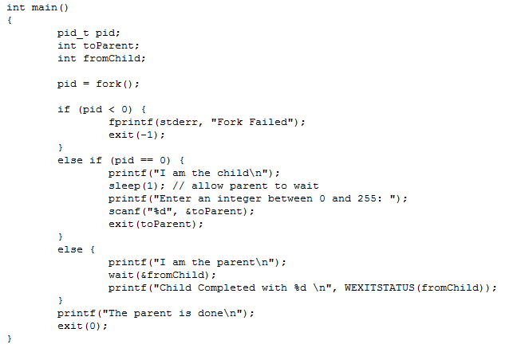
ex1.c

Slide 80
POSIX Threads

Slide 81
Overhead of Processes
Processes allow the OS to overlap I/O and computation, creating an efficient system
Overhead:
Process creation
Context switching
Swapping
All require kernel intervention

Slide 82
Threads enhance the process concept
PC
PC
PC
PC
Traditional Process
Multi-threaded Process
A set of threads share the same address space

Slide 83
Advantages of Threads
Multithreaded-programs are easy to map to multiprocessors
It is easier to engineer applications with threads

Slide 84
Threads versus Processes
Threads (same address space) are not protected from each other
Require care from developers
Context switching is cheaper

Slide 85
Threads versus Processes
Traditional process executes a system call, it must block
A thread executes a system call, peer threads may still proceed

Slide 86
POSIX Threads
Called also Pthreads
A standard programming interface for threads in C
IEEE POSIX 1003.1c standard
A nice tutorial at : https://computing.llnl.gov/tutorials/pthreads/

Slide 87
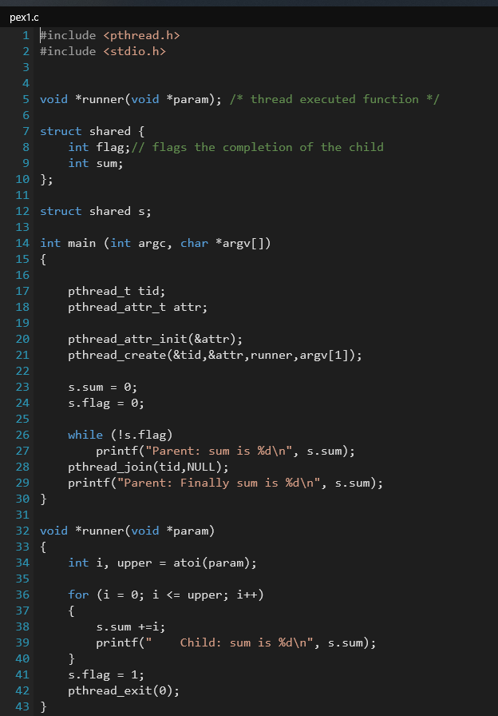

Slide 88
pex1.c
#include <pthread.h>
#include <stdio.h>
void *runner(void *param); /* thread executed function */
struct shared {
int flag; // flags the completion of the child
int sum;
};
struct shared s; // shared between parent and child threads

Slide 89
pex1.c
void *runner(void *param)
{
int i, upper = atoi(param);
for (i = 0; i <= upper; i++)
{
s.sum +=i;
printf(" Child: sum is %d\n", s.sum);
}
s.flag = 1; // I am done
pthread_exit(0);
}
Notes:
Runner can be given any name. The function will be specified in pthread_create().
Functions in C are actually just pointers to a spot in the program where some code exists. Just like you've been creating pointers to structs, strings, and arrays, you can point a pointer at a function too. The main use for this is to pass "callbacks" to other functions, or to simulate classes and objects.
This allows runner to be passed as an argument to another function.

Slide 90
int main (int argc, char *argv[])
{
pthread_t tid;
pthread_attr_t attr;
pthread_attr_init(&attr); \\get default attributes
pthread_create(&tid, &attr, runner, argv[1]);
s.sum = 0;
s.flag = 0;
while (!s.flag)
printf("Parent: sum is %d\n", s.sum);
pthread_join(tid,NULL);
printf("Parent: Finally sum is %d\n", s.sum);
}
pex1.c
Notes:
The NULL in pthread_join can be replaced by an integer variable, which will hold the value passed by the “joining” thread in its pthread_exit(n). That is, it will be n.

Slide 91
Mixing C and Assembly

Slide 92
Mixing C and Assembly
__asm__ ( "assembly code"
: output operands /* optional */
: input operands /* optional */
);

Slide 93
